Slide 1
More Applications of
The Pumping Lemma
Costas Busch - LSU

Slide 2


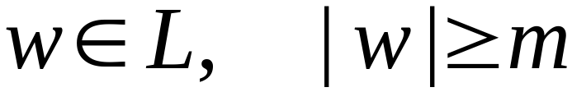

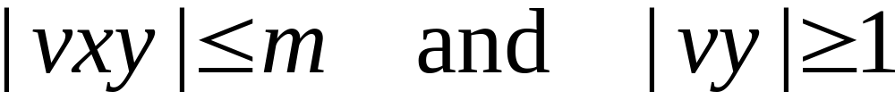
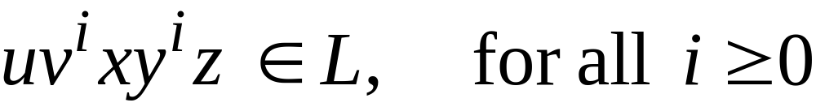
The Pumping Lemma:
For infinite context-free language
there exists an integer such that
for any string
we can write
with lengths
and it must be:
Costas Busch - LSU

Slide 3
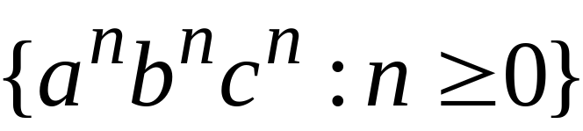
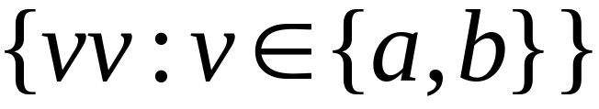

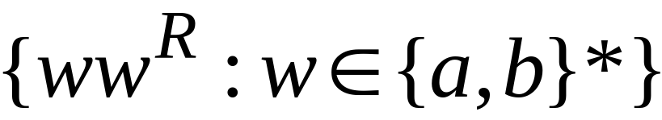
Non-context free languages
Context-free languages
Costas Busch - LSU

Slide 4
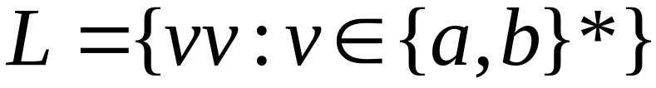
Theorem:
The language
is not context free
Proof:
Use the Pumping Lemma
for context-free languages
Costas Busch - LSU

Slide 5
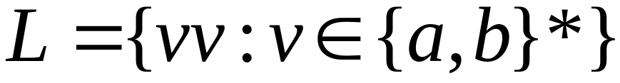
Assume for contradiction that
is context-free
Since is context-free and infinite
we can apply the pumping lemma
Costas Busch - LSU

Slide 6
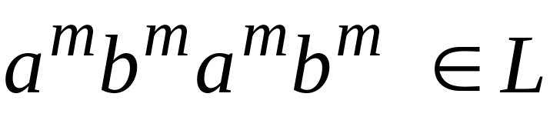
Pumping Lemma gives a magic number
such that:
Pick any string of with length at least
we pick:
Costas Busch - LSU

Slide 7
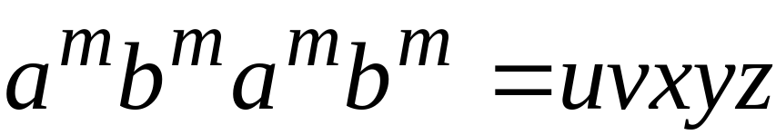
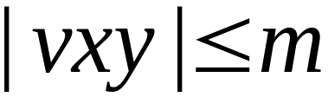
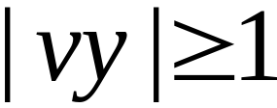
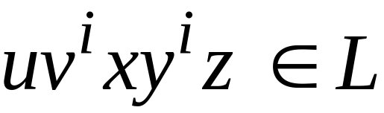

We can write:
with lengths and
Pumping Lemma says:
for all
Costas Busch - LSU

Slide 8
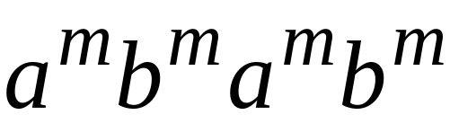

We examine all the possible locations
of string in
Costas Busch - LSU

Slide 9
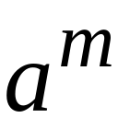
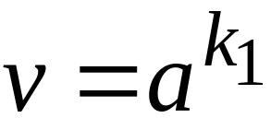
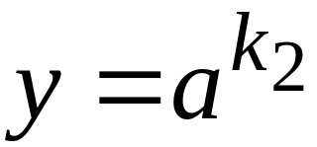
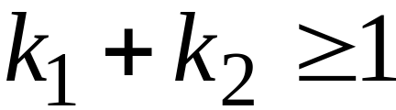





Case 1:
is within the first
Costas Busch - LSU

Slide 10
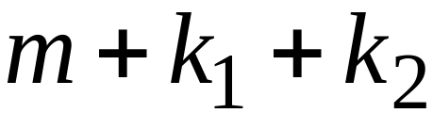
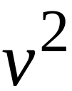
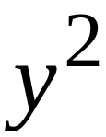
Case 1:
is within the first
Costas Busch - LSU

Slide 11
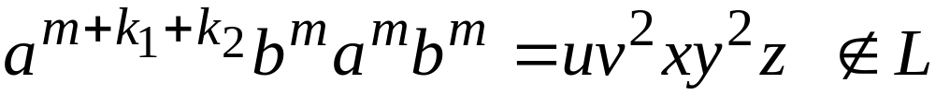
Case 1:
is within the first
Costas Busch - LSU

Slide 12
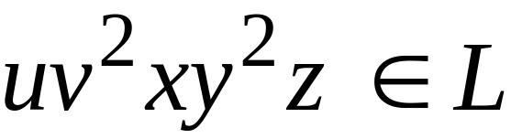
Case 1:
is within the first
However, from Pumping Lemma:
Contradiction!!!
Costas Busch - LSU

Slide 13
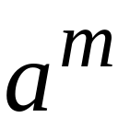
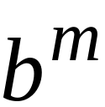
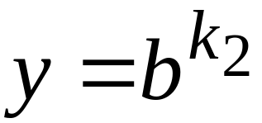
Case 2:
is in the first
is in the first
Costas Busch - LSU

Slide 14
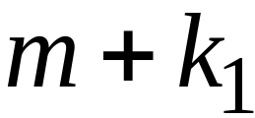
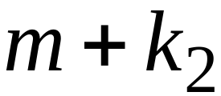
Case 2:
is in the first
is in the first
Costas Busch - LSU

Slide 15
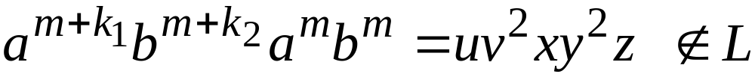
Case 2:
is in the first
is in the first
Costas Busch - LSU

Slide 16
Case 2:
is in the first
is in the first
However, from Pumping Lemma:
Contradiction!!!
Costas Busch - LSU

Slide 17
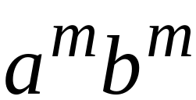
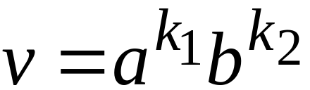
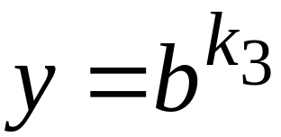
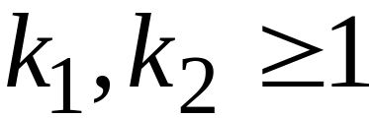
Case 3:
overlaps the first
is in the first
Costas Busch - LSU

Slide 18


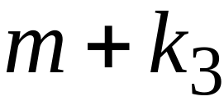
Case 3:
overlaps the first
is in the first
Costas Busch - LSU

Slide 19
Case 3:
overlaps the first
is in the first
Costas Busch - LSU

Slide 20
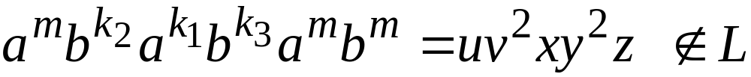
Case 3:
overlaps the first
is in the first
However, from Pumping Lemma:
Contradiction!!!
Costas Busch - LSU

Slide 21
Case 4:
in the first
Overlaps the first
Analysis is similar to case 3
Costas Busch - LSU

Slide 22
Other cases:
is within
or
or
Analysis is similar to case 1:
Costas Busch - LSU

Slide 23
More cases:
overlaps
or
Analysis is similar to cases 2,3,4:
Costas Busch - LSU

Slide 24
There are no other cases to consider
Since , it is impossible
to overlap:
nor
nor
Costas Busch - LSU

Slide 25
In all cases we obtained a contradiction
Therefore:
The original assumption that
is context-free must be wrong
Conclusion:
is not context-free
Costas Busch - LSU

Slide 26
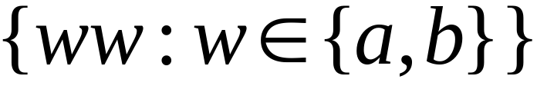
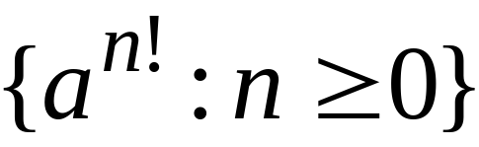
Non-context free languages
Context-free languages
Costas Busch - LSU

Slide 27
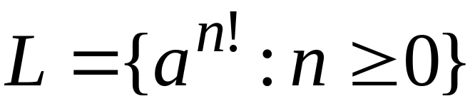
Theorem:
The language
is not context free
Proof:
Use the Pumping Lemma
for context-free languages
Costas Busch - LSU

Slide 28
Assume for contradiction that
is context-free
Since is context-free and infinite
we can apply the pumping lemma
Costas Busch - LSU

Slide 29
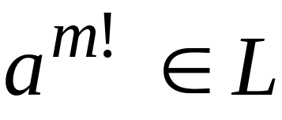
Pumping Lemma gives a magic number
such that:
Pick any string of with length at least
we pick:
Costas Busch - LSU

Slide 30
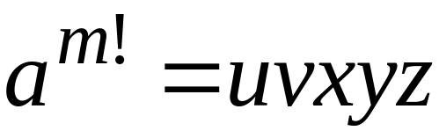
We can write:
with lengths and
Pumping Lemma says:
for all
Costas Busch - LSU

Slide 31
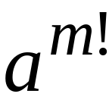
We examine all the possible locations
of string in
There is only one case to consider
Costas Busch - LSU

Slide 32


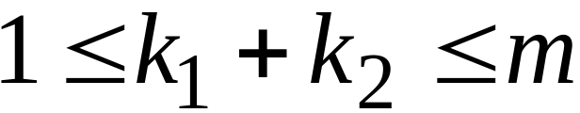
Costas Busch - LSU

Slide 33
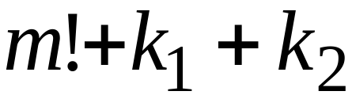

Costas Busch - LSU

Slide 34

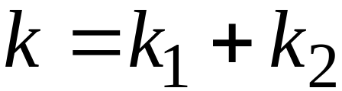

Costas Busch - LSU

Slide 35
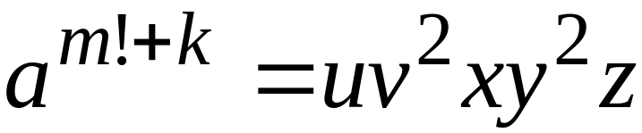
Costas Busch - LSU

Slide 36

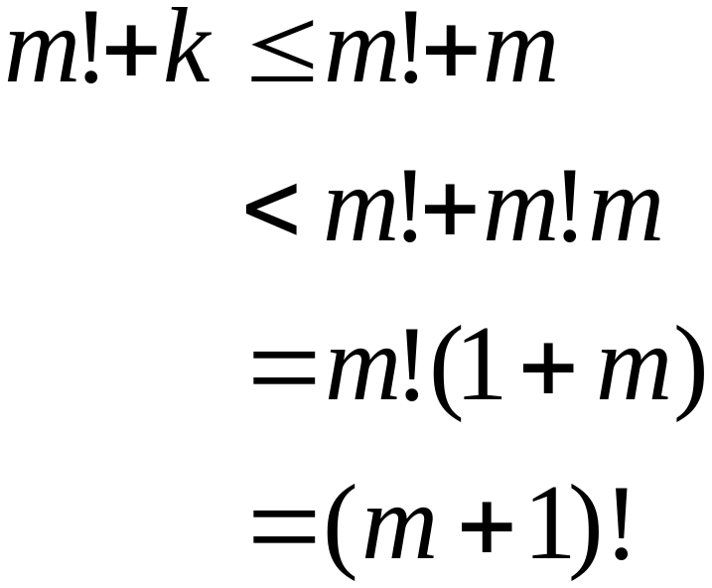
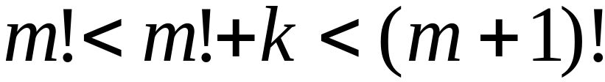
Since , for we have:
Costas Busch - LSU

Slide 37
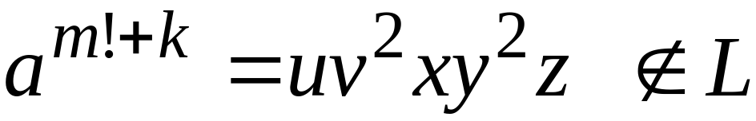
Costas Busch - LSU

Slide 38
However, from Pumping Lemma:
Contradiction!!!
Costas Busch - LSU

Slide 39
We obtained a contradiction
Therefore:
The original assumption that
is context-free must be wrong
Conclusion:
is not context-free
Costas Busch - LSU

Slide 40
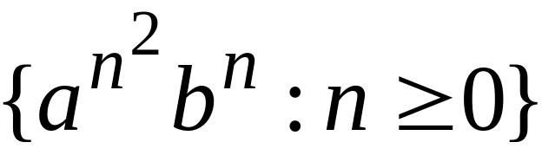
Non-context free languages
Context-free languages
Costas Busch - LSU

Slide 41
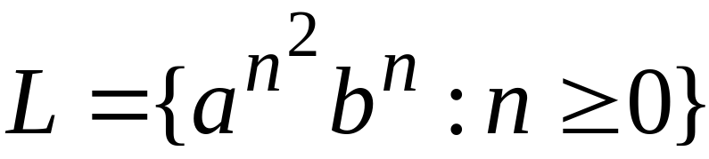
Theorem:
The language
is not context free
Proof:
Use the Pumping Lemma
for context-free languages
Costas Busch - LSU

Slide 42
Assume for contradiction that
is context-free
Since is context-free and infinite
we can apply the pumping lemma
Costas Busch - LSU

Slide 43

Pumping Lemma gives a magic number
such that:
Pick any string of with length at least
we pick:
Costas Busch - LSU

Slide 44

We can write:
with lengths and
Pumping Lemma says:
for all
Costas Busch - LSU

Slide 45

We examine all the possible locations
of string in
Costas Busch - LSU

Slide 46


Most complicated case:
is in
is in
Costas Busch - LSU

Slide 47
Costas Busch - LSU

Slide 48


Most complicated sub-case:
and
Costas Busch - LSU

Slide 49





Most complicated sub-case:
and
Costas Busch - LSU

Slide 50

Most complicated sub-case:
and
Costas Busch - LSU

Slide 51


and
Costas Busch - LSU

Slide 52

Costas Busch - LSU

Slide 53

However, from Pumping Lemma:
Contradiction!!!
Costas Busch - LSU

Slide 54
When we examine the rest of the cases
we also obtain a contradiction
Costas Busch - LSU

Slide 55
In all cases we obtained a contradiction
Therefore:
The original assumption that
is context-free must be wrong
Conclusion:
is not context-free
Costas Busch - LSU

